Slide 1
Austria‘s Economy: recent performance and long term economic policy orientation
Presentation by Günther Chaloupek, ÖGB
for CMKOS/FES Seminar
Prague April 5/6, 2016

Slide 2
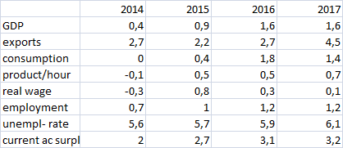
Austria: current indicators

Slide 3
Austria: current indicators
modest growth
export driven: high growth of commodity exports, high current surplus (goods and services)
high employment growth in comparison to GDP growth →
modest increase of overall productivity
rising unemployment: most serious concern for ÖGB
weak consumption growth
low real wage increases

Slide 4
Austria – recent economic policy measures
fight against unemployment top ÖGB priority
increasing economic growth is difficult under conditions of „austerity“ imposed by EU institutions → more expansionist, esp. Germany
in Austria: strengthen investment, esp. public i.
boost for domestic demand: reduction of income tax 2016 greatest sucess for ÖGB in recent years
big reduction of marginal tax rate for low and middle incomes →
increase in real wages after tax 2016 +2,6% (as compared to wages before tax only 0,1%) – one time effect only

Slide 5
Post-recession performances (GDP) AU, CZ, GE, €A compared

Slide 6
Post-recession performances GDP compared

Slide 7
Post-recession performance GDP compared

Slide 8
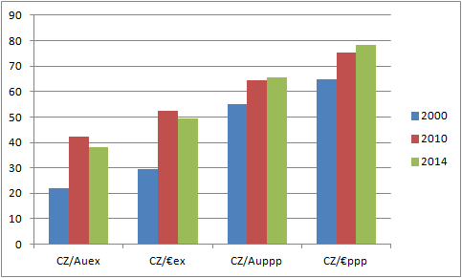
Catching up process GDP per capita

Slide 9
Catching up process GDP per capita

Slide 10
GDP per capita (in €)
 | 2005 | * 2011 | 2014
Germany | 28.300 | 33.700 | 36.000
Austria | 30.800 | 36.800 | 38.500
Poland | 6.400 | 9.900 | 10.700
Portugal | 15.100 | 16.700 | 16.700
Slovakia | 7.300 | 13.000 | 13.900
Czech Republik | 10.700 | 15.600 | 14.700
Hungary | 9.000 | 10.100 | 10.600
* Ende der Übergangsfrist
Quelle: Statistisches Bundesamt Deutschland

Slide 11
Catching up process GDP per capita
CZ catching up fast 2000-2010
at current exch rates much faster than at PPP
slowdown in catching up process
at exch rates slower than at PPP →
irregularity
reason: currency depreciation

Slide 12
Catching up process Austria
Austria‘s catching up phase 1960-1973: GDP growth p.a. average 5% - very favourable international conditions!!
1973-1990: GDP growth p.a. average 2,3%
„balanced growth model“: high export growth plus high growth of domestic demand, esp. consumption → wage increases in line with increase of overall productivity (average 1960-1973 4% p.a.+ inflation rate)
maintains international competitiveness

Slide 13
Catching up process Austria
no devaluation, „hard currency policy“ from 1969 to 1999 (€)
fixed exchange rate vis á vis DM
substantial appreciation vis á vis LIT, FF, GBP, etc. →
constant pressure upon industry (and export oriented services, e.g. tourism) to improve product structure
policy had strong support from ÖGB, while some branches of industry called for softening of exchange rate regime
conditions for success: constant improvement of international competitiveness (growth of productivity, labour unit cost increases!)
encompassing price and wage policy by system of Sozialpartnerschaft

Slide 14
Austria‘s Social Partnership System
tripartite system: Sozialpartner + government
employees‘ organizations: ÖGB and Arbeiterkammer*
business organization: Economic Chamber (Wirtschaftskammer –WKÖ*)
Landwirtschaftskammer* (Chamber of Agriculture)
Government
permanent system!!
* mandatory membership !!!

Slide 15
Austria‘s Social Partnership System
until 2000: „Paritätische Kommission“
formal institution of Social Partners: Beirat für Wirtschafts- und Sozialfragen (expert advisory board)
since 2000: mostly informal, ad hoc related to matter under discussion
Social Partners represented on many governmental advisory bodies (labour market, Wirtschaftsförderung, agricultural market system, fiscal council, etc.)
Selbstverwaltung for institutions of social insurance (health, pensions, accident)

Slide 16
Austria‘s Social Partnership System
WAGE POLICY
more than 200 Kollektivverträge (collective agreements) for economic branches
duration one year
indirect coordination through wage leadership of Gewerkschaft ProGe (for metal industries)
counterpart: sections of WKÖ
almost 100% coverage through collective agreements, also in the public sector
principle of productivity oriented wage policy
hardly any strikes
no government interference in wage negotiations
no legal minimum wage

Slide 17
Austria‘s Social Partnership System
current problems:
opposition to social partnership from some sectors of Austria‘s private industry is increasing (risk of strikes)
bargaining position of Unions is still strong in industry, becomes weaker due to rising unemployment
process of tertiarisation (many low wage branches) fuelled by rapid growth of labour supply resulting from immigration from CEE countries
challenge of increasing minimum wages through collective agreements in service branches, e.g. retail, security, etc
increasing difficulty to ensure participation af wages in productivity gains
adverse attitudes from new political forces, esp. „Neos“-Party which advocates sharp cuts in the pension system
„wir kämpfen weiter“

Slide 18
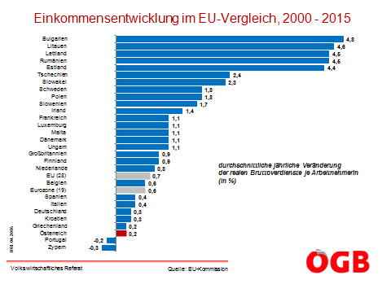

Slide 19
Structure of commodity exports by country 2014 CZ (left), AU (right)

Slide 20
Structure of commodity exports by country 2014

Slide 21
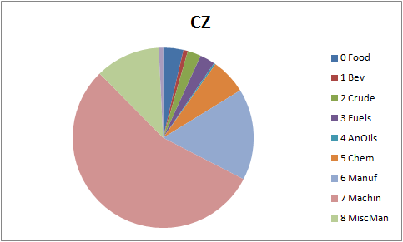
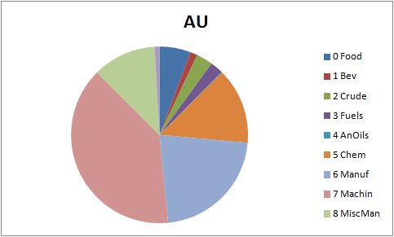
Structure of commodity exports 2014

Slide 22
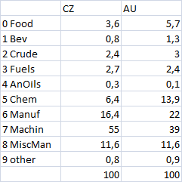
Structure of commodity exports 2014

Slide 23
THE END thank you!

